Slide 1
Scalable Time Series Classification
Patrick Schäfer, Humboldt University of Berlin, Knowledge Management in Bioinformatics
patrick.schaefer@hu-berlin.de
22.09.2016

Slide 2
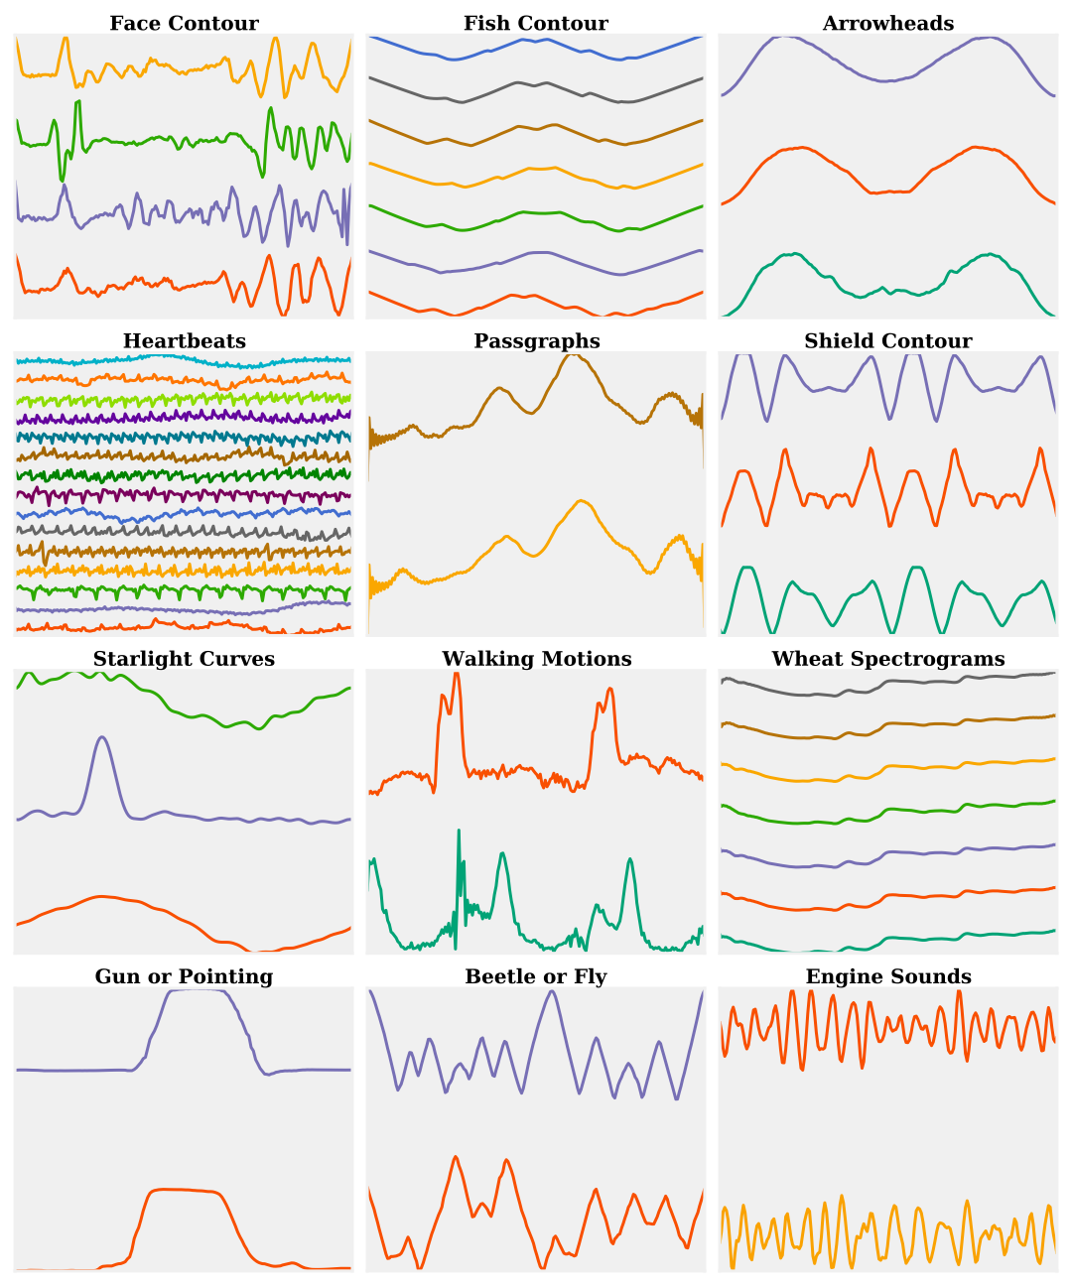
Time Series
Time series result from recording data over time.
A 2d signal can be interpreted as a time series.
Includes motion sensors, personalized medicine (ECG/EEG signals), machine surveillance, spectrograms, astronomy (starlight-curves), and image outlines/contour of objects.
Notes:
A one-dimensional time series (TS) is a collection of values sequentially ordered in time. They are increasingly popular due to the growing importance of automatic sensors producing an increasing flood of large, high-resolution TS in areas such as

Slide 3
Time Series Classification
Model
Time series classification aims at assigning a class label to an unlabeled query time series based on a (trained) model.
find
label
Query

Slide 4
UCR time series archive is the gold standard in TS research.
At most thousands of time series with thousands of measured values for a single dataset.
Over all datasets there are 50.000 train and 100.000 test time series or 55 Million values.
These datasets led to
a wealth of time series classification algorithms…
with high computation complexities.

Slide 5
 | Train | Predict
1-NN DTW | - | O(Nn²)
1-NN DTW with warping window | O(Nn²) | O(Nnr), 0.01<r<1
Shapelets (LS, ST, Fast) | O(N²n³) to O(Nn²) | O(Nn) to O(n)
Bag-of-Patterns (BOSS, SAX VSM) | O(N²n²) to O(Nn³) | O(Nn)
Ensembles (COTE, EE PROP) | O(N²n³) | O(Nn²)
N=#time series,
n=times series length
r=warping window size
Notes:
Ensembles of 36 (COTE) and 11 (EE PROP) core-classifiers are state-of-the-art.
All approaches have quadratic to cubic computational complexity in N or n.

Slide 6
Accuracies
90.7%
97.9%
97.8%
94.1%
Notes:
video runs at 32 times of the actual runtime.
8000 samples x 1024 measurements.
We see the classification times for the StarlightCurves dataset. It contains 8000 queries with 1024 measurements each. While it is the largest dataset in TS research, it is rather small. Our method finishes within seconds.
The baseline 1-NN DTW takes longest with 7 minutes. ST is slowest. BOSS: 3 min. others < 1 minute

Slide 7
Long-term human intracranial EEG recordings
The total file size is >50GB with 240000x16x6000 measurements (6000 samples, 16 electrodes).
At the same time real-time systems emerge: Billions of measurements for thousands of sensors.
Smart Plugs
„4055 Millions of measurements for 2125 plugs distributed across 40 houses.“
Real-Time Location System
„The total filesize
is 2.6 GB and it contains a total of 49,576,080 position events.“
Notes:
But there are also larger datasets.
Three different challenges.
Long-term human EEG recordings: Forecast seizures of epilepsy patients. 16 electrodes. (multivariate time series)
DEBS 2014: real-world energy consumption profiles from smart plugs deployed in households. Queries: Load Prediction & Outlier Detection
DEBS 2013: Real-Time Locating System (RTLS). Data set was recorded during a soccer game between two teams of 8 players. Queries per Player: Running Analysis (speed and distance), Ball Possession, Heat Map, Shots on Goal (trajectories)

Slide 8
Can we be much faster AND (almost) as accurate as state-of-the-art?
Notes:
The focus of this word is a low computational complexity combined with high accuracy.

Slide 9
BOSS in Vector Space (BOSS VS)
1.) word transformation
2.) bag-of-patterns
Notes:
Outline and Building Blogs
BOSS VS consist of two building blogs: a word transformation of substructures and a bag-of-patterns model.
I will go into details on the following slides.

Slide 10
Raw Data
BOSS
BOSS VS
￼
Notes:
In the beginning we have the raw data and want to extract words

Slide 11
Notes:
BOSS VS is based on the BOSS model. BOSS extracts sliding windows, transforms windows to SFA words, and builds the histogram.
Window length is critical parameter

Slide 12
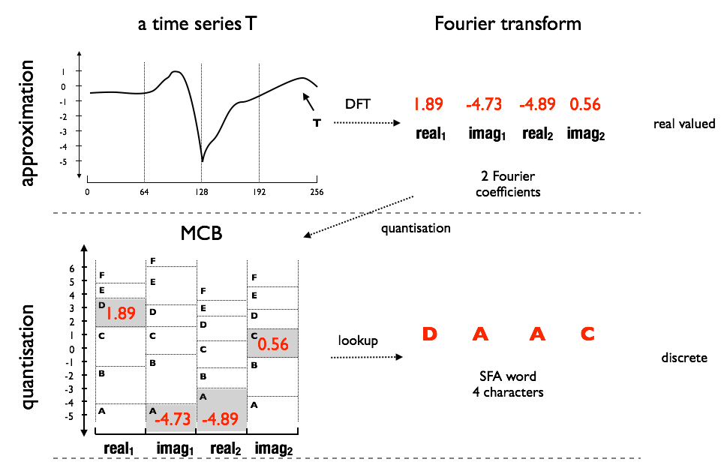
From real values to discrete words
Notes:
SFA transform a time series using the Fourier Transform.
It applies a low past filter using only the first Fourier coefficients.
Quantizes each Fourier value to a symbol.

Slide 13
Raw Data
BOSS
BOSS VS
Bag-of-Patterns
Notes:
First raw data. 3 different classes. bells cylinders and funnels.
substructures are extracted from a time series,
each substructure is transformed to a word.
A histogram of word counts is built
A tf-idf feature vector is constructed for each class.

Slide 14
Raw Data
BOSS
BOSS VS
tf-idf

Slide 15
BOSS VS
Based on bag-of-patterns model.
Uses tf-idf vectors for each class (independent from sample size).
Incremental Fourier transform for linear time Fourier transform of overlapping windows.
Fast prediction in O(n): Cosine similarity between tf-idf vectors.
Fast training in O(Nn^{3/2}) due to a small parameter space:
Tests sqrt(n) windows at equidistance.
8 SFA Word lengths.
tf-idf
Notes:
The term frequency refers to the occurrence of words in a document. The tf-idf measure is used to weigh the term frequencies in the vector to give a higher weight to representative terms (words) of a class. In our model the term is an SFA word and a document corresponds to a time series.

Slide 16
State-of-the-Art Core Classifiers
Core-classifiers:
Baseline: 1-NN Dynamic Time Warping (CV)
Shapelets (LS, ST, FS)
Bag-of-Patterns (BOSS, TSBF, SAX VSM, BOP)
Bag-Of-SFA-Symbols in Vector Space (BOSS VS)
Ensembles (we only consider core-classifiers now)
EE PROP, COTE

Slide 17
BOSS VS is 1-2 orders of magnitude faster than state-of-the-art.
Notes:
BOSS VS is orders of magnitude faster than state-of-the-art! 2.5 orders of magnitude faster in training. very low prediction times.
Based on core UCR archive (46 datasets)
But is is accurate as well?

Slide 18
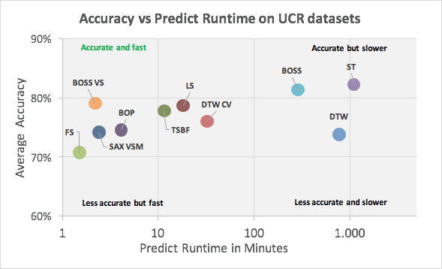
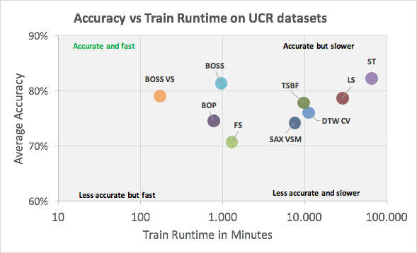
Trade-off between Accuracy and Runtime
BOSS VS offers a high accuracy combined with a low runtime.
Notes:
What we see: average accuracy plotted against the total runtime. Ideally we want a method that is in the upper left corner: fast and accurate. BOSS VS is the closest to this corner. it is up to 2.5 orders in magnitude faster but has a competitive accuracy.
Shapelet methods have a higher train time. Bag-of-pattern methods generally have a lower computational complexity.

Slide 19
Average Ranks on UCR datasets
BOSS VS is competitive with state-of-the-art.
Notes:
If we look at ranks, BOSS VS is in the group of best classifiers. Only BOSS and ST have a much lower rank.
Ranks based on all 85 UCR datasets.

Slide 20
Conclusion
There is a trade-off between accuracy and computational complexity.
BOSS VS is designed for fast train, test times, and high accuracy.
It is orders of magnitude faster than state-of-the-art and almost as accurate.

Slide 21
Thank you!

Slide 22
Average Ranks on 85 UCR datasets
vs Ensemble Classifiers

Slide 23
Average Ranks on 85 UCR datasets
vs baseline classifiers
BOSS VS is significantly more accurate and faster than 1-NN DTW!

Slide 24
Computational Complexity
 | Train | Predict
1-NN DTW | - | O(Nn²)
1-NN DTW CV | O(Nn²) | O(Nnr), 0.01<r<1
Shapelets (LS, ST, Fast) | O(N²n³) to O(Nn²) | O(Nn) to O(n)
Bag-of-Patterns (BOSS, SAX VSM) | O(N²n²) to O(Nn³) | O(Nn)
Ensembles (COTE, LS) | O(N²n³) | O(Nn²)
BOSS VS | O(Nn^{3/2}) | O(n)
N=#time series,
n=times series length
r=warping window size

Slide 25
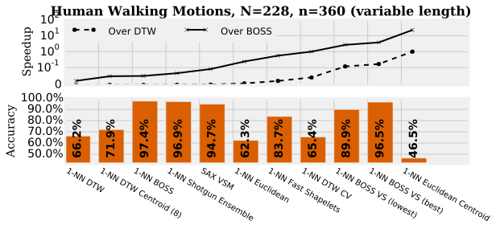
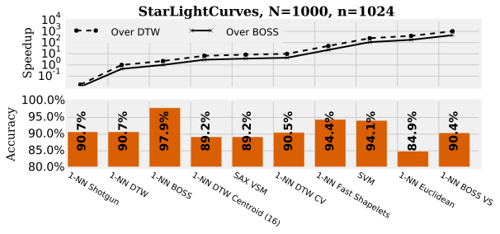
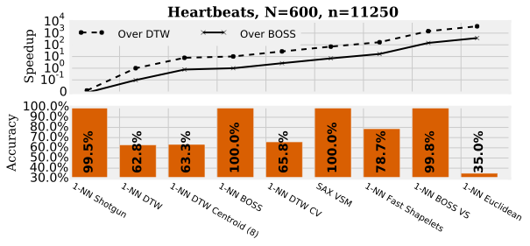

Slide 26
